Slide 1
Electronics Shop
Presented by:
Shady Mohamed Tarek 19100178
Loay Mohamed Gaber 19101664
Ahmed Sobhy Metawea 19103156

Slide 2
Introduction:
Application allows administrators add products to database, remove and edit products in database.
Customers can have an account that can be used to access store and view our products.

Slide 3
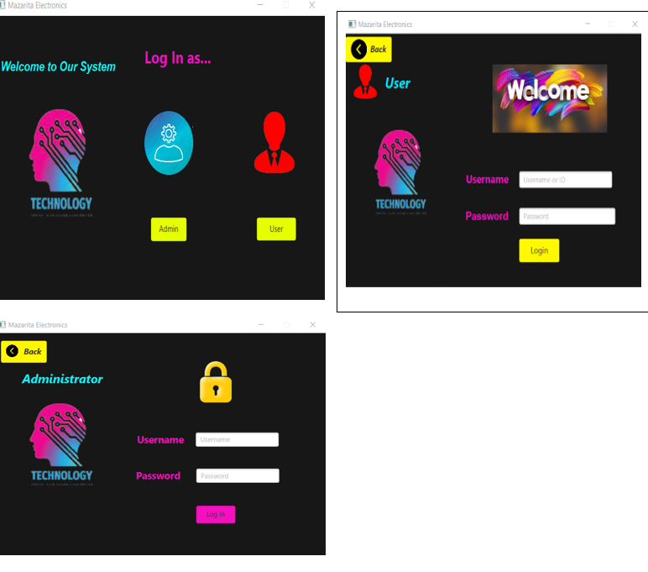
GUI
These are the forms used to login as an admin or a customer.

Slide 4
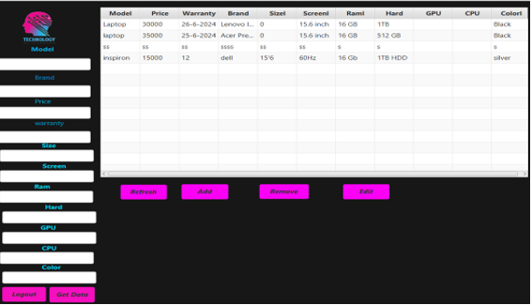
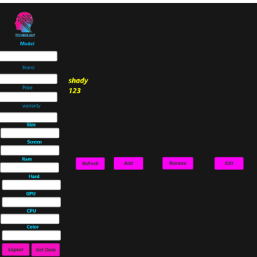
These show how admin can add , remove, edit and also get his data.

Slide 5
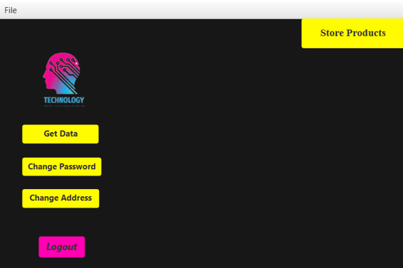
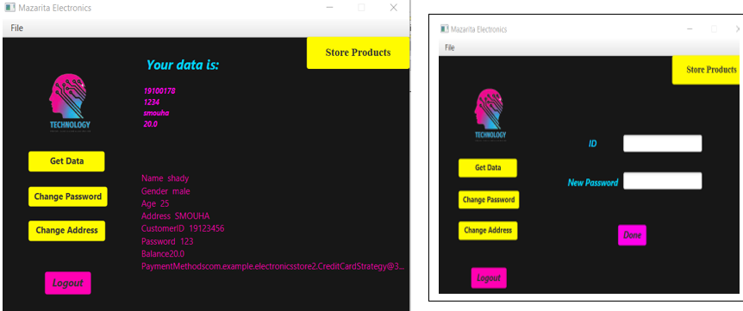
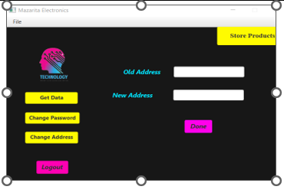
Here the customer can get his data as well as change his address and password and can access the store.

Slide 6
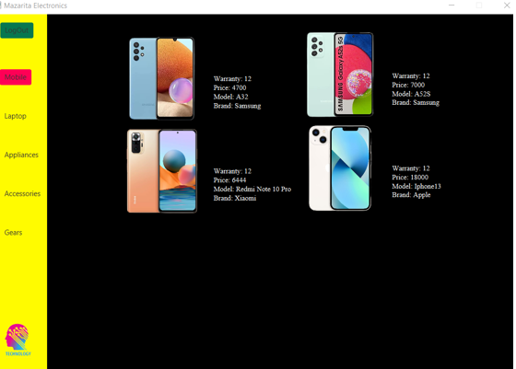
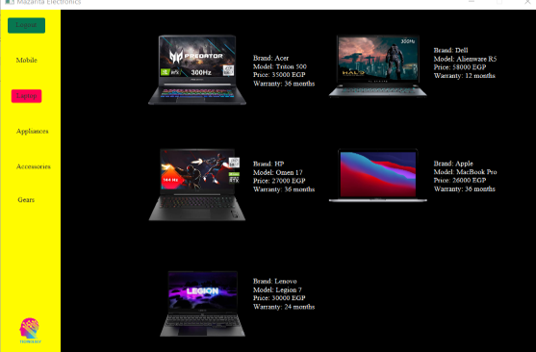
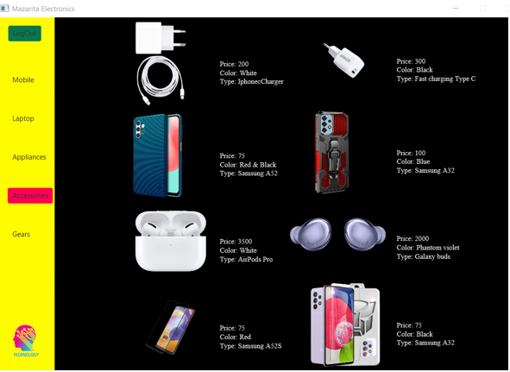
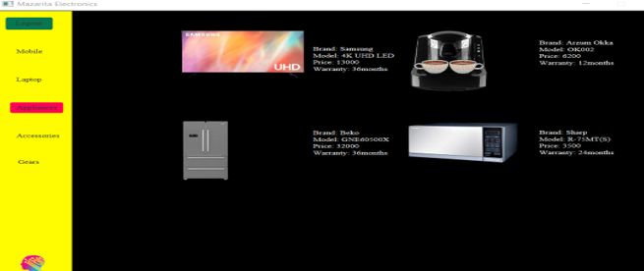

Slide 7
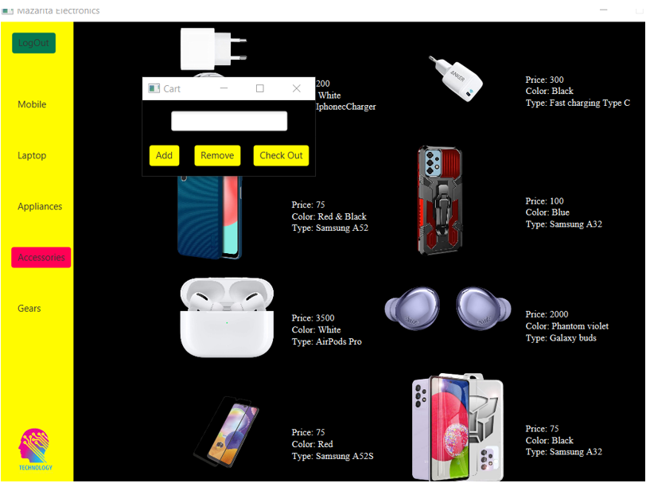
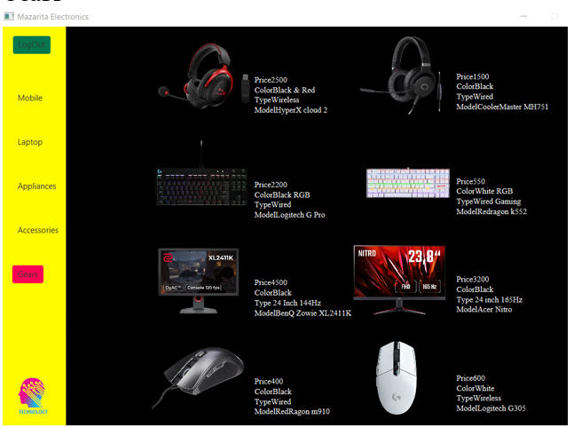
This is how our store is looking like were the user can easly use it

Slide 8
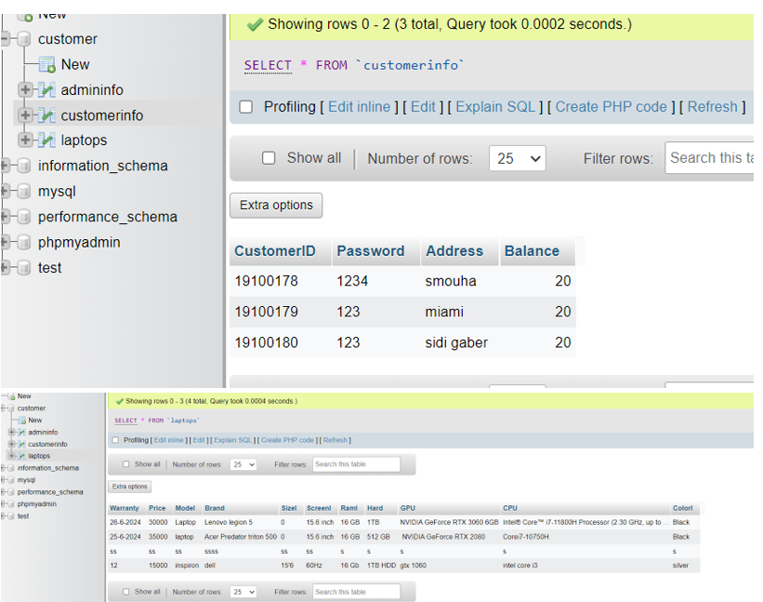
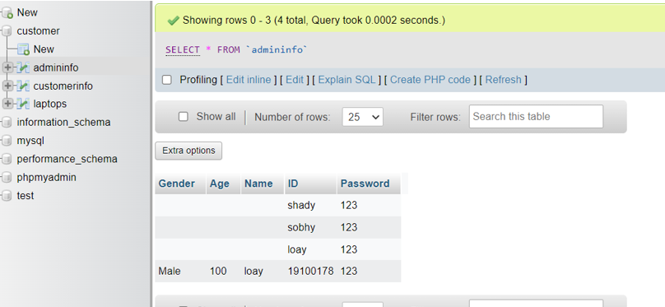
Database

